Slide 1


Adult/Dislocated Worker Program Report
July 1, 2025 – September 30, 2025

Slide 2
Total Active Enrollments 7-1-25 – 9-30-25

Slide 3


Slide 4
Performance Outcomes Update

Slide 5
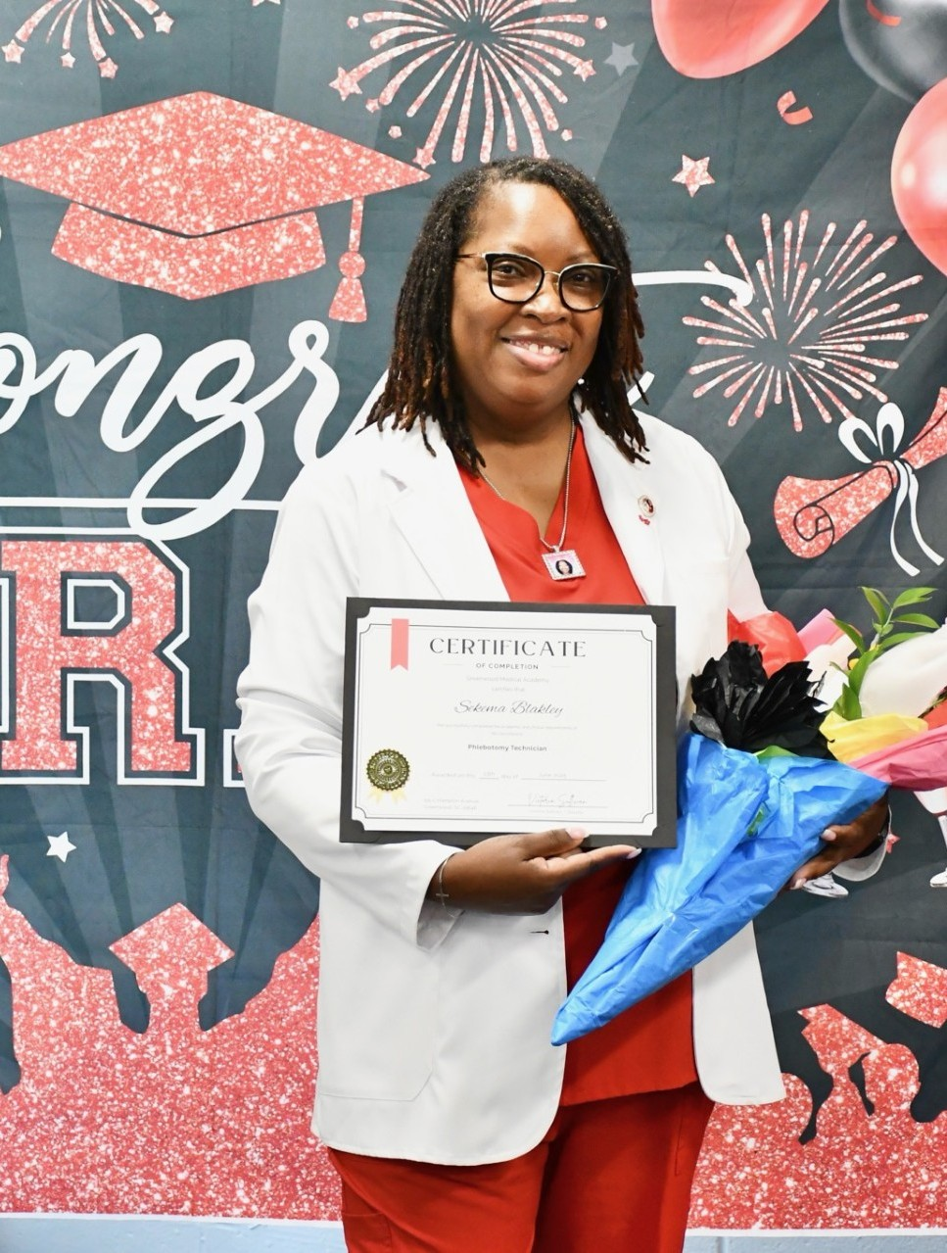
WIOA Dislocated Worker Success Story Sekema B.
Sekema spent 29 years working in manufacturing before unexpectedly losing her job when the plant she worked at shut down. Faced with uncertainty and the challenges of reentering the workforce, she knew she wanted a fresh start in a meaningful career. Healthcare had always interested her, but going back to school after so many years and without stable employment, felt overwhelming. After learning about the WIOA program, Sekema applied and was accepted. With support from Ms. Tamika Goggins, she enrolled in the Phlebotomy Technician program at Greenwood Medical Academy in Greenwood, SC. Through WIOA, her tuition was fully covered, and she received personalized support throughout her training. Sekema also benefited from job search assistance, which kept her motivated and focused on her goals. Upon completing the program, Sekema was hired by Grifols Plasma as a Phlebotomist I. She began working on June 26, 2025, earning $17 per hour and working 40 hours per week. Today, she is thriving in a career she’s passionate about, with a stable and promising future ahead. With support from WIOA, Sekema turned a challenging chapter into a stepping stone toward long-term career success.

Slide 6

Youth Program Report
July 1, 2025 – September 30, 2025

Slide 7
Total Active Enrollments 7-1-25 – 09-30-25

Slide 9
Performance Outcomes Update

Slide 10
Performance Outcomes Update 7-1-25 – 09-30-25

Slide 11
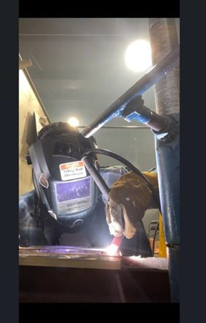
WIOA Youth Success Story Avondre M.
Avondre, 25, joined the WIOA program on August 16, 2024, determined to overcome significant personal barriers, including not having a GED and facing transportation challenges. Over the past year in the program, he has worked steadily to build a better future and pursue a career in the welding industry. During his time in the program, Avondre took deliberate steps to achieve his goals. He earned his GED through Greenwood Adult Education and participated in Career Smart workshops, where he developed key job-readiness skills such as resume building, interview preparation, and workplace professionalism. These efforts demonstrated his resilience, focus, and determination to succeed. After completing his GED and skill-building activities, Avondre enrolled in welding training at Norris Mechanical School in Anderson, SC. He successfully completed the initial level of training, gaining the hands-on skills necessary to advance in his chosen career path. Avondre is now actively seeking employment while preparing to begin Welding 102, the next level of instruction that will further enhance his expertise. With his dedication and perseverance, he is steadily moving toward his long-term dream of owning and operating his own welding company, turning his hard work into a sustainable and rewarding career.

Slide 12
One-Stop Center Operations Report
July 1, 2025 – September 30, 2025

Slide 13
SC Works Center Traffic
Center Traffic Counts | September 2025 | Program Year 25’
Greenwood | 593 | 1948
Laurens | 138 | 456
Edgefield | 8 | 20
Abbeville | 2 | 9
McCormick | 4 | 6
Newberry | 327 | 965
Saluda | 0 | 5
Total Center Traffic: | 1072 | 3409

Slide 14
SC Works System Services
September 2025
SC Works Orientation Attendance | 12
Hiring Events | 5
Employers at Hiring Events | 57
Job Seekers at Hiring Events | 158
Number of Referrals | 15
Soft Skills Activities | 20
Workshops Offered | 18
Employer Services | 742

Slide 15
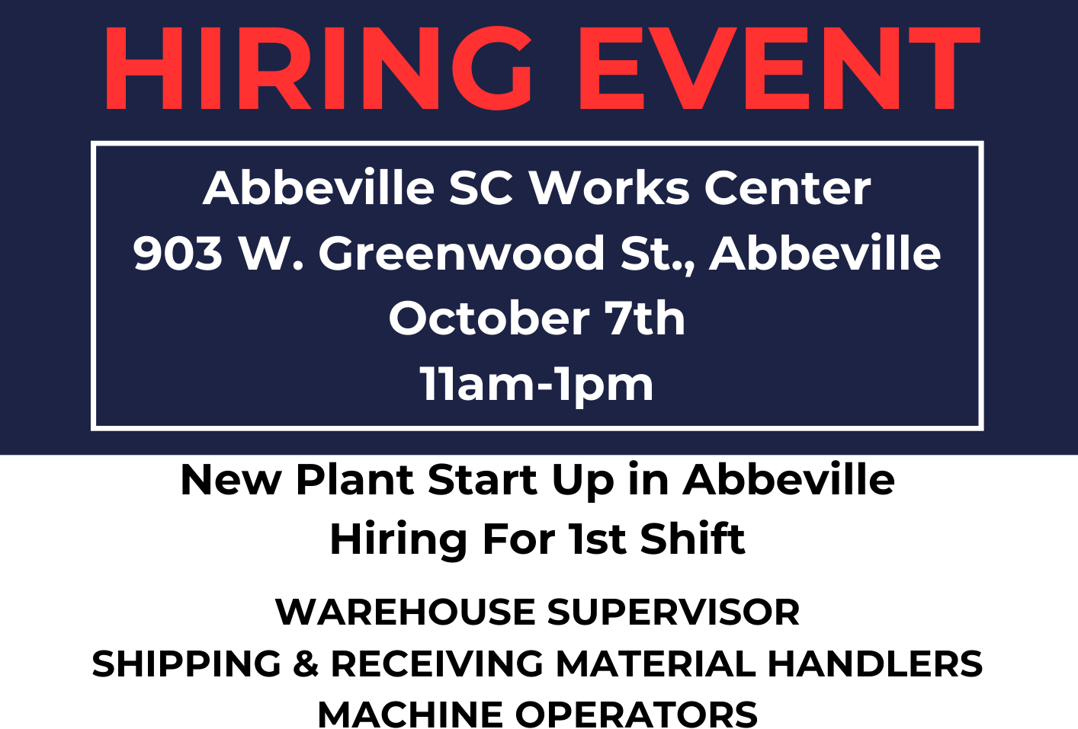
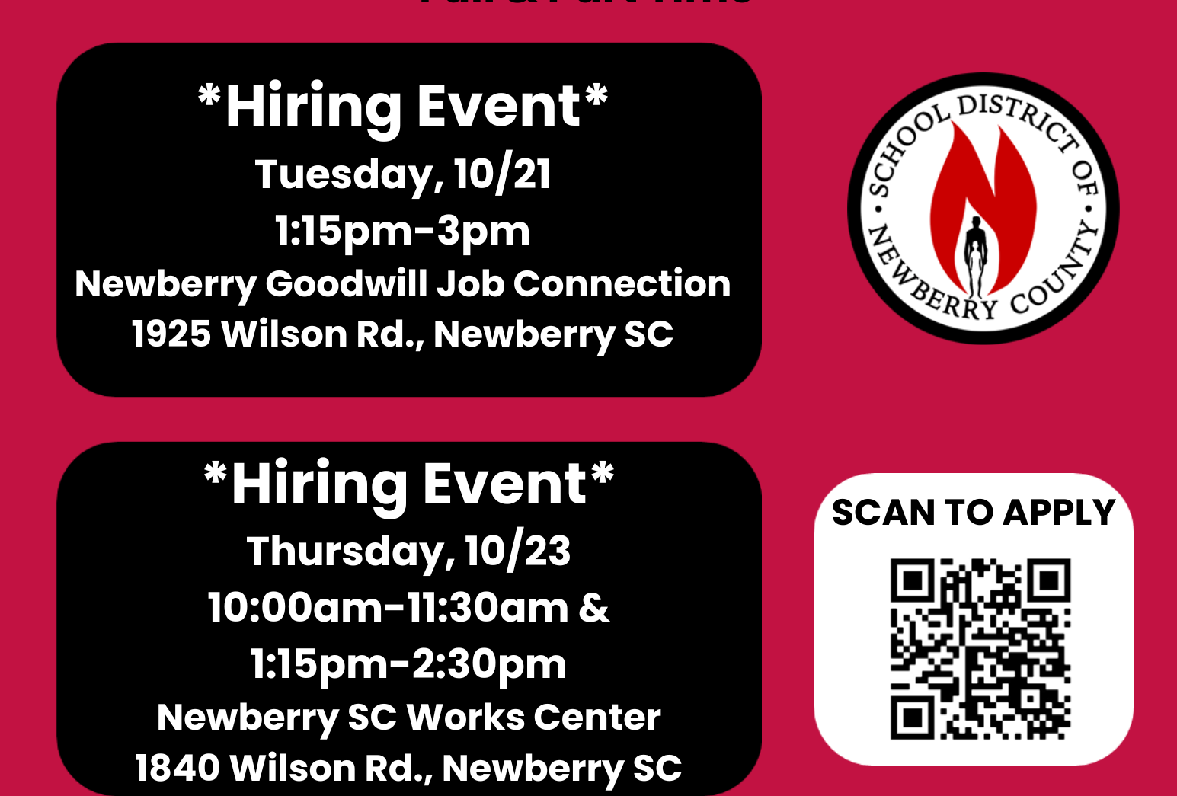
Hiring Events

Slide 16
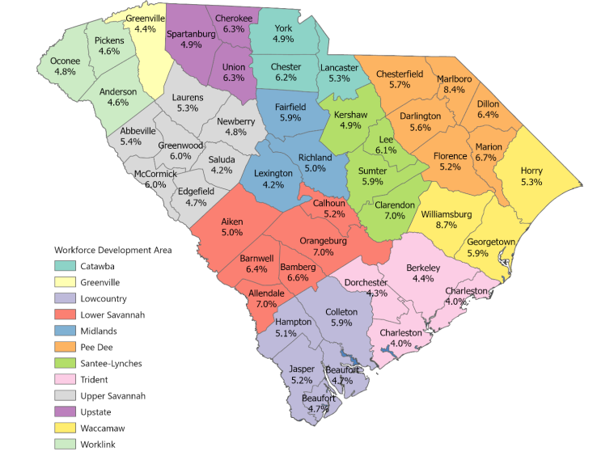
Unemployment Rate by County (Not Seasonally Adjusted)

